Slide 1


Brain Teaser
Mobile Application Development – Project Presentation
Instructor
Team TechMighties
Dr. Pradeep Buddharaju, Ph.D.
Associate Professor, UHCL
Razia Sultana Patan
Chandrasekhar Konuru
Vignesh Kirubakaran
Sai Bhargav Ram Bikki

Slide 2
Contents
Introduction
Design
Implementation
Workflow
Demonstration
Team Management
Conclusion
Presented by Razia Sultana Patan

Slide 3
Introduction
Native iOS Application
Exercises your brain by solving math questions
Enhances basic math solving skills
Brian Teaser
Presented by Razia Sultana Patan

Slide 4

Application Scope
Contains 3 levels – Easy, Medium and Hard
Played by a single player
Creates dynamic questions based on selected level
Have to decide if the math expression is correct or wrong
Can solve any number of questions in 30 seconds
Keeps track of best score for a selected level
Maintains history of all scores achieved by a player
Plays appropriate audio on answering the questions
Presented by Razia Sultana Patan

Slide 5
Design - Algorithm
operator = randomSelectionFrom(+, -, /, x)
If (level==easy){
initialize a and b to random number from 1 to 10
correct = a operator b
wrong = correct + randomNumberFrom(-5, 5)
} else if (level== Medium){
initialize a and b to random number from 11 to 20
correct = a operator b
wrong = correct + randomNumberFrom(-3, 3)
} else {
.
.
initialize a and b to random number from 21 to 30
correct = a operator b
wrong = correct + randomNumberFrom(-2, 2)
}
showCorrectOrWrong = random(0,1)
If (showCorrectOrWrong == 0){
Question = “ a operator b = wrong”
ActualAnswer = false
}else If (showCorrectOrWrong == 1){
Question = “ a operator b = correct”
ActualAnswer = true
}
Add to list (Question, ActualAnswer, correct)
Presented by Razia Sultana Patan

Slide 6
Design - Score
Level | Correct Answer | Wrong Answer
Easy | Score = Score + 10 | Score = Score - 5
Medium | Score = Score + 20 | Score = Score - 7
Hard | Score = Score + 30 | Score = Score - 10
Presented by Chandraseker

Slide 7
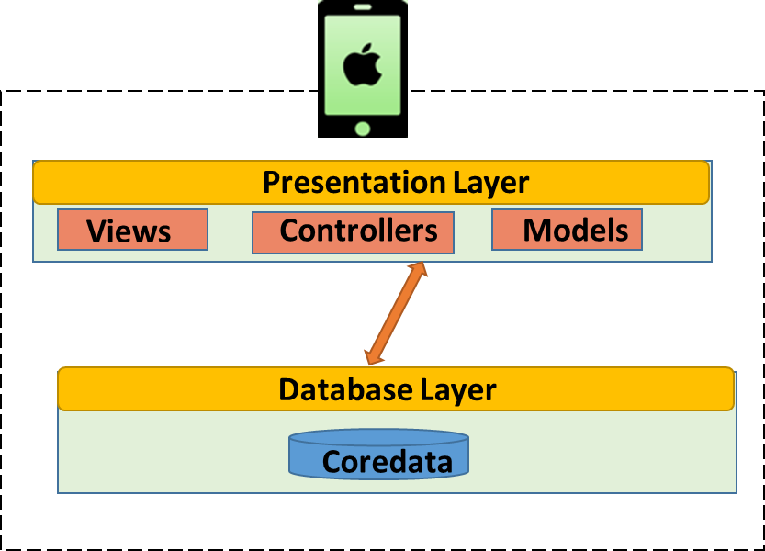
Design - Architecture
Presented by Chandraseker

Slide 8
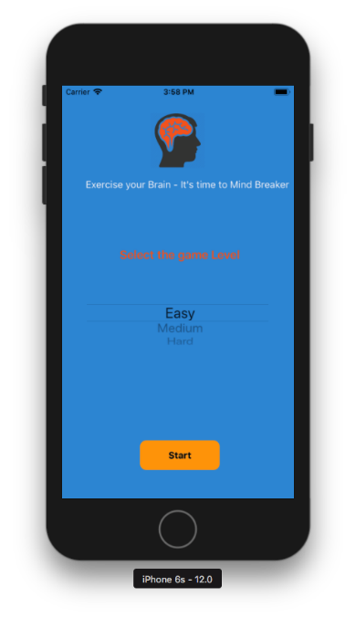
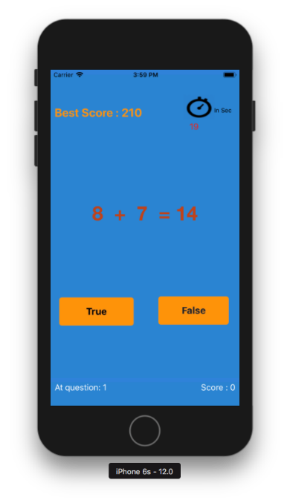
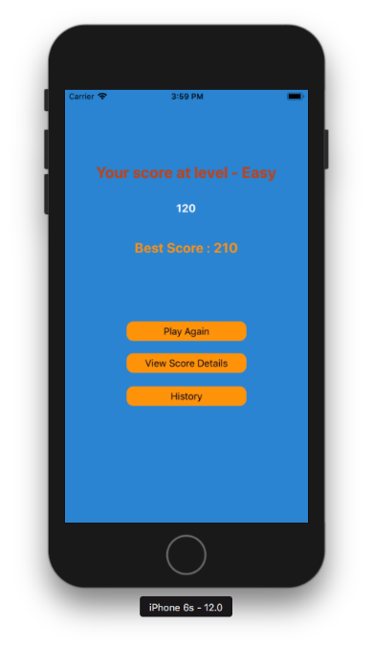
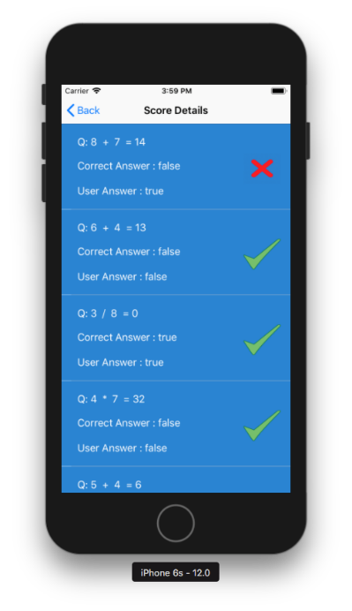
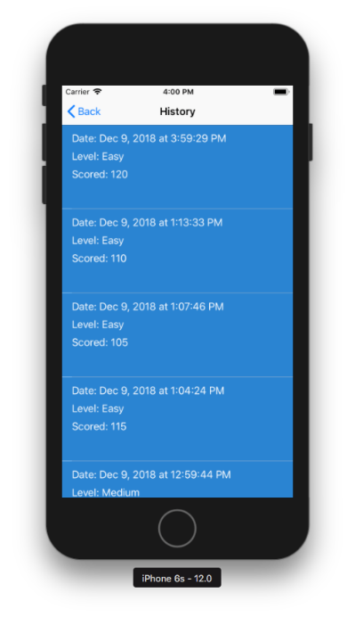
Design - Overview
Home View
Quiz View
Score View
Solution View
History View
SQLIte
Presented by Chandraseker

Slide 9
Technology
Frameworks
Cocoa Touch Framework
AV Foundation Framework
Coredata Framework
Hardware and Software
Programming Language: Swift 4
Tool: Xcode
Hardware: MAC Desktop and iPhone
Presented by Sai Bhargav

Slide 10
Application Work Flow
Brain Teaser
Level Selection
View
Player View
Score View
Score Detail View
History View
Presented by Sai Bhargav

Slide 11
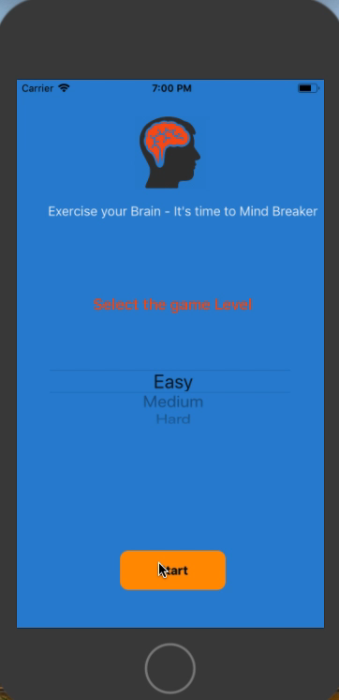
Brain Teaser Demonstration
Presented by TechMighties

Slide 12
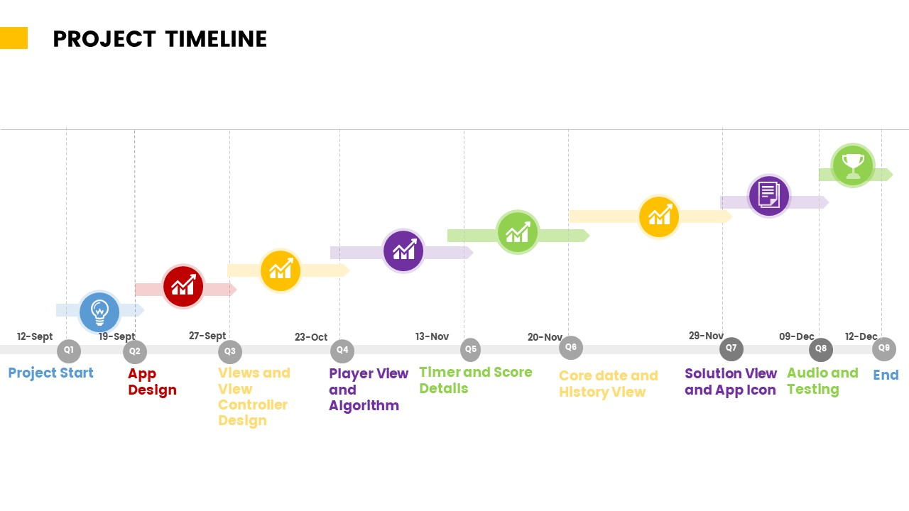
Project Timeline
Presented by Sai Bhargav

Slide 13


Task Division
Chandu & Bhargav
Razia & Vignesh
Player View Functionality
Solution Detail Table View
Timer Functionality
Core data
Questions change based on selected level
Testing and bugs
Home View Functionality
Score logic and Result View
History Table View Functionality
Audio Functionality
Color change of button based on selected answer
Testing and bugs fixing
Presented by Vignesh

Slide 14
Conclusion
Challenges
Scalable
Dynamic Questions, Flash colors of buttons, Score logic
Built scalable architecture using: Swift 4, SQLite
Way Out
MVC Architecture
Updated the UI on same view and used random function, changed color for certain time
Followed a modular approach based on MVC architecture
Teamwork
Future Work
Each team member brought in a collaborative approach
Multiplayer mode with networking support.
Presented by Vignesh

Slide 15
Acknowledgement
Dr. Buddharaju
Mobile Application Development Fall 2018 Students
For the peer support during presentations through out the semester.
University of Houston - Clear Lake
For giving us the opportunity to showcase our abilities and learn along the way.
For guiding us providing the academic support by helping us throughout the project.
Presented by Vignesh

Slide 16
References
Stackoverflow
Lecture Materials
Apple Documentation
Google
https://www.raywenderlich.com/6338-swift-tutorial-part-1-expressions-variables-and-constants
https://itunes.apple.com/us/book/swift-programming-language/id881256329
Presented by Vignesh

Slide 17


